Slide 1
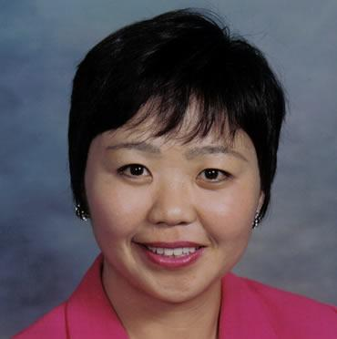
國際健康專業人士計劃
International Health Professional Program
Michelle Yao
高級顧問經理級
Director
四個佣金週期共賺取HK$138,000
HK$138,000 in 4 Commission weeks
本簡報中提到的收入等級純屬舉例說明，無意代表美安香港經銷商的一般收入，也無意表示任何經銷商皆可賺取同等收入。美安香港經銷商的成功與否，取決於其在發展事業時的努力、才能與投入程度。The income levels mentioned in the following presentation are for illustration purposes only. They are not intended to represent the income of a typical Market Hong Kong Distributor, nor are they intended to represent that any given Independent Distributor will earn income in that amount. The success of any Market Hong Kong Independent Distributor will depend upon the amount of hard work, talent, and dedication which he or she devotes to building his or her Market Hong Kong Business.

Slide 2

以保健計劃支援健康專業人士的病人與診所
Supporting Health Professionals
With Wellness for Your
Patients and Practice

Slide 3
為健康專業人士提供服務
Serving the Health Care Community
美安香港正迅速成長，目前已推行計劃幫助香港的健康專業人士利用這些功效卓越的保健產品支援他們病人的健康
透過實行保健方案，我們亦為健康專業人士帶來額外收入
如你所知，能產生盈利的生意才是成功。我們為你的病人和顧客提供問題的解決方案，從而提高診所的業務收入
Market Hong Kong is growing quickly and we are quickly taking steps to help health professionals in Hong Kong leverage the exceptional results of these wellness products to support the health of their patients.
By implementing wellness solutions for the patients, we also add ancillary income for the health professionals.
As you know, every business must run profitably to succeed. We can improve revenue in any business by providing the answers to the questions that your patients or customers are asking.

Slide 4
首先，讓我們聽聽病人的問題
Let’s start by listening to the questions that patients are asking.
｢你有何建議助我控制體重？｣
｢你建議我用哪一種綜合維他命、鈣和 魚油產品？｣
｢我還有甚麼其他保健方法可以選擇？｣
“What do you recommend to help me lose weight?”
“What multivitamin, calcium or fish oil do you recommend?”
“What healthy alternatives do I have?”

Slide 5
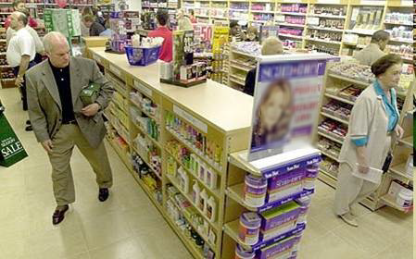
實際上病人已經在購買保健產品……
Patients Are Already Purchasing Wellness Products…
已經有人向病人推銷補充品
你的病人在買甚麼產品？
誰向他們提供建議？
Patients have already been sold on supplementation.
WHAT are your patients buying?
Who is giving them advice?

Slide 6
一般消費者受過科學和營養方面的教育嗎？
Is the average consumer educated in science-based, nutritional support?
很多最流行品牌的標簽上列出林林總總的成份，看來很吸引，但當中常常含有不健康的成份
  化學色素
  化學合成香味劑
  防腐劑
  崩解劑
  增量劑，如滑石粉或澱粉、氫化油或化學膜衣
Many of the most popular brands have attractive labels full of ingredients, but often contain unhealthy ingredients:
  Artificial chemical dyes
  Artificial, chemically synthesized flavoring agents
  Preservatives
  Disintegrating agents
  Bulk fillers such as talc or starch, hydrogenated oil, chemical coatings

Slide 7
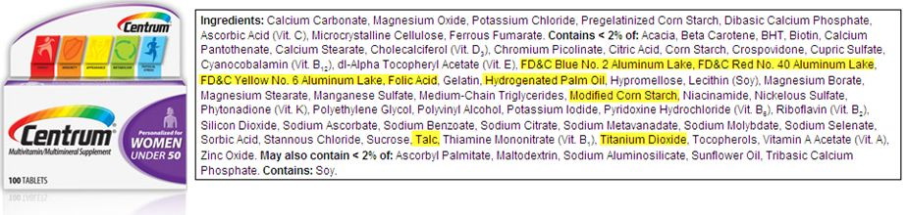
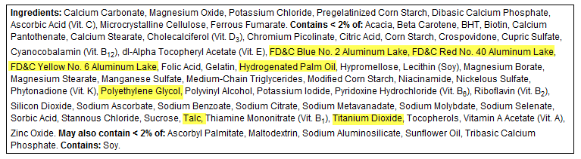
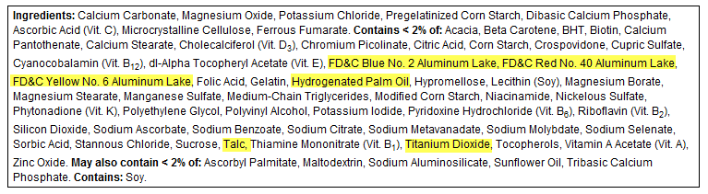
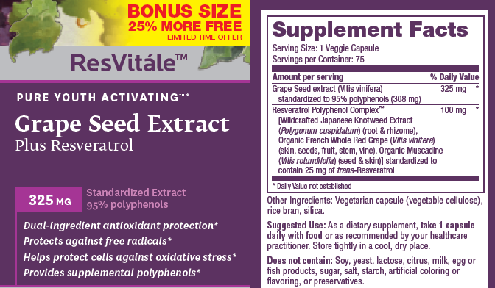
知名商店的補充品標籤
Popular Store Supplement Labels
Centrum® Women Under 50 is a product of Pfizer Consumer Healthcare. For more information, visit
http://www.centrum.com/centrum-women-under-50#tablets
ResVitale™ Grape Seed Extract is a product of GNC Live Well. For more information, visit http://www.gnc.com/GRAPE-SEED-EXT-RESVERATROL/product.jsp?productId=24272346&cp=3593185.12961325
Notes:
Many popular brands have ingredients that are not healthy. We can see by looking at the labels. Most patients are not educated in these topics.

Slide 8
美安香港對品質的承諾
Market Hong Kong Commitment to Quality
美安香港的產品以先進成份、科學根據和卓越品質管制領先業界
產品代理的優點：
  由頂級製造商中篩選出市場需求最殷切的暢銷產品
  根據當前的科研成果提供綜合、互相輔助的配方
  提供由業界專家調配、種類繁多的產品
Market Hong Kong products lead the industry thanks to cutting-edge ingredients, sound science and exceptional quality control
The Product Brokerage Advantage:
  Identifies the latest market-driven products from the best manufacturers.
  Provides comprehensive and synergistic formulations based on current research
  Offers a wide variety of products formulated by experts in the industry

Slide 9
美安香港對品質的承諾
Market Hong Kong Commitment to Quality
每項產品製造時都遵照嚴格的品質管制指引，並經持續品質監控：
  針對原料及製成品設定規格
  原料具有分析報告
  產品製造過程採用標準操作程序，並於定期查核符合GMP（良好生產規範）的製造設施內製造
  我們會於倉庫內就損壞、標籤準確性、外觀、味道和氣味方面進行檢驗，才准許運出產品
  產品會由獨立實驗室檢測等滲壓功能、微生物污染及效力
Every product is manufactured with strict quality control guidelines and continuous quality control monitoring.
  Specifications are set for raw materials and finished products.
  Raw materials are sourced with Certificates of Analysis.
  Products are manufactured using Standard Operating Procedures in manufacturing facilities that are audited on a regular basis for GMP compliance.
  Products are inspected at our warehouse for damage, label accuracy, appearance, taste and odor prior to release.
  Products are assayed by independent labs for isotonic capability, micro contamination and potency.

Slide 10

美安香港與眾不同
Market Hong Kong Difference
等滲壓營養
吸收效率極高的優質丸狀和膠囊補充品
綜合全面的解決方案
可量度的病人效果
以科學為本的解決方案
讓你有別於其他具相同專長的診所
Isotonic-capable nutrition
High-quality tablets & gel caps that have exceptional absorption rates
Comprehensive solutions
Measurable patient results
Science-based solutions
Setting you apart from other practices of the same specialty
Notes:
One of main things that sets our products apart from the competition is our isotonic capable formulas. With no binders and fillers, the isotonic solutions deliver maximum absorption for patient results. With the right ingredients and right absorption into the body, patients get results, and our doctors do also. We also have very high quality pills and gel caps that are also designed for successful patient results. Not every product can be delivered in isotonic form, but with the best product design and technology, our pill formulations also deliver results the patients can experience.

Slide 11
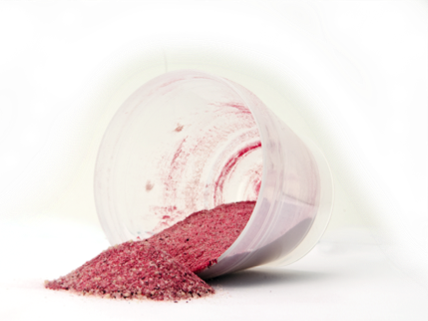
等滲壓營養
Isotonic-Capable Nutrition
  Superior nutrient delivery
  Exceptional quality control measures
  Quality sourcing of ingredients
  Comprehensive and synergistic formulations
Health Professional Value:
  Better delivery
  Better compliance
  Better results
Patient Value:
  Easy to take
  Great taste
  Results they can feel
  卓越營養輸送
  優異品質監控措施
  優質產品成份
  綜合增效配方
對健康專業人士的價值：
  更好的吸收效果
  更高的病人遵從度
  更好的效果
對病人的價值：
  易於使食
  美味可口
  可以感覺到的效果
Notes:
There are many benefits to our formulas but what matters most is that the patients get results. With that, our health professionals also get results. Quality matters and that is the first thing to look for when patients say they are already taking a supplement.

Slide 12
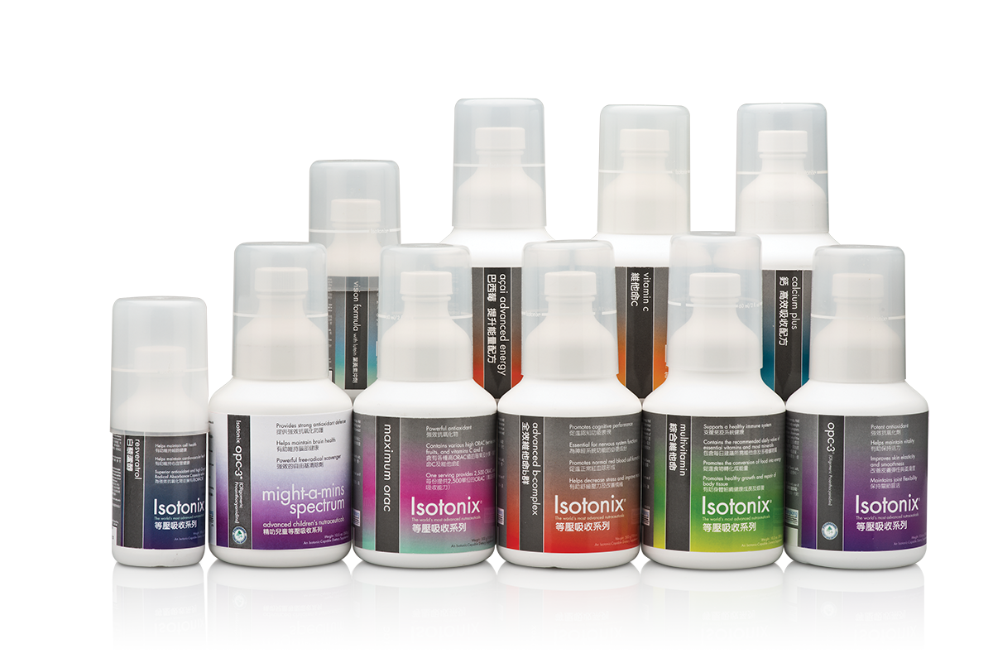
可支援你病人的產品
Products To Support Your Patients

Slide 13
主題：為你的健康及早規劃
THEME : Wellness Planning
-5 -4 -3 -2 -1 0 +1 +2 +3 +4 +5
專注於主要護理 Focus On Critical Care
保健規劃 Wellness Care
健康專業人士解決主要醫療或｢主要健康護理｣問題
保健規劃：
步驟一：你覺得今天的健康狀態如何？
步驟二：你想達成甚麼健康目標？
步驟三：如果你能改善一個健康項目，你 會選擇哪一項？
步驟四：協助病人擬定一個他們能維持的 方案，以幫助他們達成健康目標
病人日後複診
如以往一般支援主要健康護理
衡量進度並調節保健方案，並教導病人堅持改變
步驟一：你覺得今天的健康狀態如何？
步驟二：你想達成甚麼健康目標？
Health professional addresses primary concern or “Critical Care”
Wellness Planning:
Step 1: How do you feel about your health today?
Step 2: Where do you want your health to be?
Step 3: If you can improve one thing about your health, what would it be?
Step 4: Assist the patient with a solution that they can maintain to help them toward their health goal.
Future Patient Visits
Support critical care as you would normally.
Measure progress and adjust the wellness solution and teach the patient to maintain changes.
Step 1: How are you feeling today?
Step 2: If you could improve one thing about your health, what would it be?
Notes:
We

Slide 14
主題：為你的健康及早規劃
THEME : Wellness Planning
-5 -4 -3 -2 -1 0 +1 +2 +3 +4 +5
專注於主要護理 Focus On Critical Care
保健規劃 Wellness Care
範例
0 – 健康的飲食習慣
可以包括教育支援或飲食習慣的調整
1 – 必需營養支援
可以包括綜合維他命或其他必需營養
2 – 最佳健康狀態支援
可以包括產品組合，以確保他們有良好的營養基礎
3 – 個人化／針對性的保健支援
可以包括度身訂造的配方/護理方法，以針對他們的獨特需要
4 – 健康的代謝和體能
這類病人可能會積極參與改善體能和保健活動，你可以用更進階的選項支援他們
5 – 積極主動的保健支援
此類病人非常重視他們的健康，並對進階選項感興趣
EXAMPLES
0 – Healthy Dietary Lifestyle
May include education support or adjustments for dietary lifestyle.
1 – Essential Nutrition Support
May include a multivitamin or other essential nutrients
2 – Optimal Health Support
May include a product kit to help make sure they have a solid foundation for good nutrition.
3 – Customized / Targeted Health Support
This many include a customized regimen to help with what they uniquely need.
4 – Healthy Metabolism and Fitness
This patient may be motivated for fitness and good health. You can support them with more advanced options.
5 – Proactive Health Support
This patient is serious about their wellness and will be interested in advanced solutions.
Notes:
We

Slide 15
兩種收入：利潤與佣金
Two Forms of Income: Profit & Commission
我們的紅利計劃為何在保健行業產生重大的效果？
它促進多種專業人士和各種專長的合作
它為診所職員提供獎勵方案，且不會增加健康專業人士的費用
它是一個事業，可以提供真正和永續的收入，並可用來為退休作準備
它有助建立牢固的引薦網絡，幫助帶來新病人
美安香港為你提供兩種收入：
  零售利潤
  永續的佣金
Why does our compensation plan produce powerful results in healthcare?
It promotes teamwork among multiple Health Professionals
or disciplines.
It provides a solution for staff incentives at no expense to the Health Professional.
It operates as a business to provide a true, ongoing income stream that can be leveraged for retirement.
It helps to build a solid referral network in support of new patient generation.
Market Hong Kong offers you two forms of income:
Retail profit
Ongoing commissions
  *本文件提及的收入程度僅供參考，並不代表一般HP或HP1的收入，也不表示任何獨立經銷商都可以有同等級的收入。任何一位HP或HP1能否成功，端看個人發展自己的事業時的努力、才能及投入程度。The income levels mentioned are for illustration purposes only. They are not intended to represent the income of a typical HP or HP1, nor are they intended to represent that any given Independent Distributor will earn income in that amount. The success of any HP or HP1 will depend upon the amount of hard work, talent, and dedication which he or she devotes to building his or her Market Hong Kong Business.

Slide 16
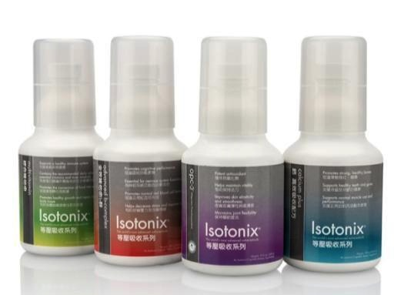
兩種收入：利潤與佣金
Two Forms of Income: Profit & Commission
Isotonix®基本營養組合 – 90天份量
Daily Essential Kit – 90 Days Supply
Code: HK6459
DC: $790.00; SR:$1,100.00; BV: 65
零售利潤範例
Retail Profit Sample
佣金範例
Commission Sample
建議零售價 ：$1,100.00
經銷商成本 ：$790.00
淨利潤 ：$310 x 500 = HK$155,000 每季
淨利潤 ：$620,000 每年
佣金
BV: 65 x 500 = 32,500BV 每季
每月 BV：11,833
Commission
BV: 65 x 500 = 32,500BV Quraterly
Monthly BV: 11,833
Suggested Retail ：HK$1,100.00
Distributor Cost ：HK$790.00
Net Profit : $310 x 500 = HK$155,000 Quarterly
Net Profit : $620,000 Annual
Notes:
This is the globla hp program, there are no nmx labels, use each country label

Slide 17
健康專業人士  兩種帳戶選擇
Two Account Options For Health Professionals
我們提供兩種類型的帳戶支援你，讓你根據業務目標選擇比較適合的帳戶
國際HP1：健康專業人士入門帳戶
  簡單的入門帳戶，為國際健康專業人士或小規模的診所而設，他們專注於自己診所的成功
  簡易、能產生盈利且自動化
  根據你的產品銷售賺取利潤和佣金
  可隨時由HP1帳戶升級至HP帳戶
  可賺取無限的零售利潤
  經由自己的零售賺取高達每週HK$11,500的BV佣金
We offer two account types to provide support in the way that best suits your business objectives.
International HP1: Health Professional Introductory Account
  Simple introductory account designed for a Health Professional or small group practice that is focused on the success of their own practice.
  Simple, easy, profitable and automated.
  Earn profit and commissions on your own product sales.
  Can upgrade from an HP1 to HP account anytime.
  Can earn unlimited retail profit.
  Can earn up to HK$11,500 per week in BV commissions on their own retail.
Notes:
Determine official name / global vs international – let’s confirm with everyone

Slide 18
健康專業人士  兩種帳戶選擇
Two Account Options For Health Professionals
我們提供兩種類型的帳戶支援你，讓你根據業務目標選擇比較適合的帳戶
國際HP：國際健康專業人士經銷商
  進階帳戶選項，為大型診所或健康專業人士而設，他們轉介病人予其他健康專業人士，並想利用我們的解決方案將其持續收入提升至最高
  可從你支援的其他健康專業人士和利用你的引薦人脈市場所產生的業績點數獲得佣金
  可賺取無限的零售利潤，並具有無限的BV佣金收入潛力
  此賬戶的要求與一般經銷商一樣
We offer two account types to provide support in the way that best suits your business objectives.
International HP : Health Professional Distributor
  Advanced account option designed for large practices or Health Professionals who refer patients with other Health Professionals and want to leverage our solution to maximize their ongoing income.
  Able to receive commissions on Business Volume from other professionals you support & leverage your referral market.
  Can earn unlimited retail profit and leverage unlimited potential in BV commissions.
  This account has the same requirements as a regular Distributor.

Slide 19
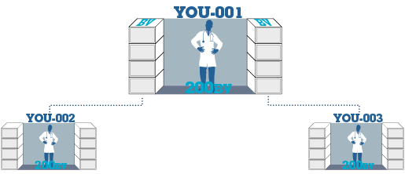

了解HP1如何運作
Understanding How HP1 Works…
5,000
5,000
= HK$4,600
3,600
3,600
= HK$2,300
2,400
2,400
= HK$2,300
1,200
1,200
= HK$2,300
________________
HK$11,500
每週收入潛力
Weekly Potential
  國際HP1是一個簡化的帳戶選項，可讓健康專業人士透過銷售產品及業績點數(BV)賺取零售利潤和佣金。國際HP1無需符合一般經銷商要求，因此可專注於其診所與病人間的互動
  健康專業人士可賺取無限的零售利潤和高達每週HK$11,500的BV佣金，且無需符合擴展業務、1000表格或自動購貨要求
  他們只能透過自己的銷售賺取BV佣金
  A simplified account type that allows Health Professionals to get paid BOTH retail AND commissions on their own sales and Business Volume (BV). This allows them to focus on their own practice and patients in a simple manner, without the requirements of a regular distributorship.
  Health professionals will earn unlimited retail profit and up to HK$11,500 per week in BV Commissions, without activation requirements, Form 1000 or Transfer Buy.
  They may only earn BV Commissions on their own sales.

Slide 20



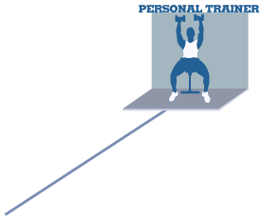








第二選項：國際HP（正式經銷商）
有助你利用現有的引薦人脈網絡增加收入
Option 2: International HP (Full Distributor)Helps Leverage Your Existing Referral Network For Additional Income
Five Steps To Successfully Implement Market (Country)® Into Your Practice
向美安香港超連鎖店主
引薦那些需要為病人提供保健服務
或為診所創造收入的健康專業人士
Refer professionals who need
wellness for their patients or
revenue for their practice to your
Market Hong Kong UnFranchise Owner.
Notes:
Creative – please change the text items for HP specialty to text objects so they can be changed on the fly instead of embedded in the graphic. NOTE: Distributor: If you know the specialties of the professionals you are working with you can edit the specialty names to target the prospects you are working with.

Slide 21
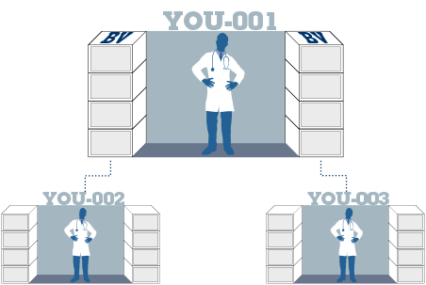
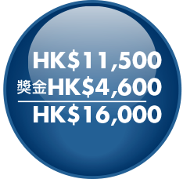







第二選項：國際HP帳戶
Option 2: International HP Distributor Account
HP帳戶提供無限的收入潛力，並具有進一步的事業發展
5,000
5,000
= HK$4,600
HP帳戶另需符合要求，包括訓練和每月要求，與其他超連鎖店主一樣
3,600
3,600
= HK$2,300
2,400
2,400
= HK$2,300
1,200
1,200
= HK$2,300
加入新的美安香港健康專業人士，以支援發展新的位置和引薦
= HK$11,500
+ HK$4,600 管理獎金 Management Bonus
HK$16,100
美安香港健康專業人士協力合作，提供事業發展的支援
根據紅利計劃
賺取的管理獎金
Management bonus earned according to compensation plan.
HP Distributor Account provides unlimited income potential to leverage additional business development.
Additional requirements include training and basic monthly requirements. Same as other UnFranchise™ Owners.
重複此過程以達成
每週收入潛力
Repeats To Achieve
Weekly Potential
每年收入潛力達
Annual earning potential of
HK$837,200
Add additional Market Hong Kong professionals to support development of additional locations or referrals.
Market Hong Kong professionals partner to provide business development support.
業績點數(BV)的報酬按紅利計劃100%被分享
Business Volume (BV) compensation is shared 100% according to compensation plan.

Slide 22
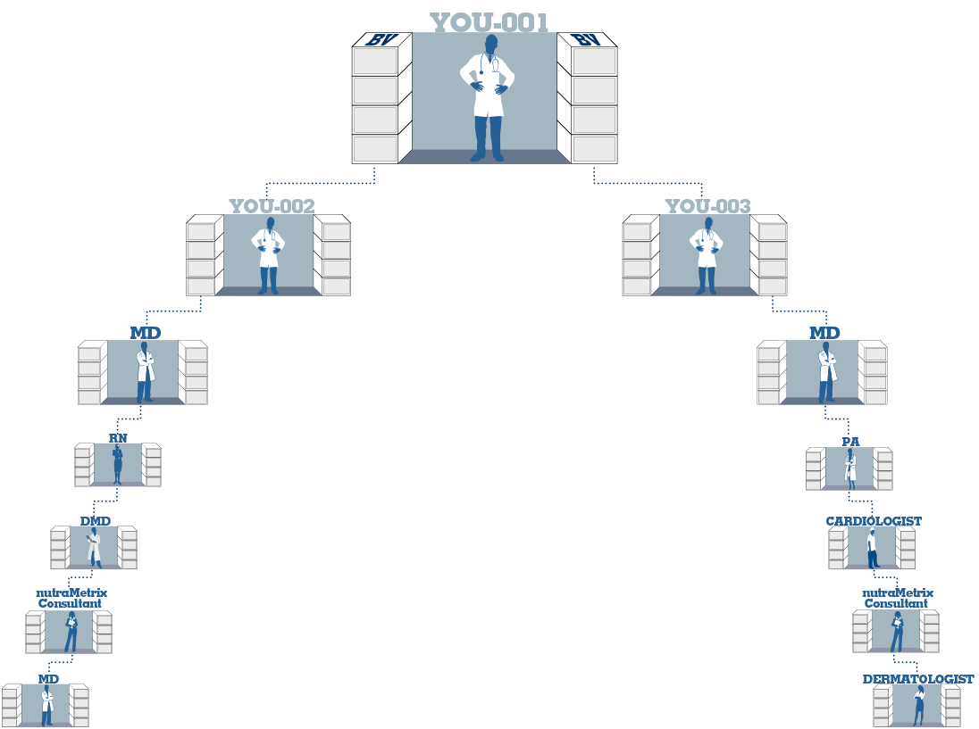








第二選項：國際HP帳戶 — 借力使力
開拓更多商業發展中心
Option 2: HP Distributor Account — Leverage Additional Business Centers
你可選擇透過拓展更多商業發展中心增加收入
借力於更多的美安公司／美安香港超連鎖™店主，發展新的事業
可透過連鎖分店加入建立更多商業發展中心。詳情請參閱完整的紅利計劃
You have the option to increase income by activating additional Business Development Centers.
By leveraging additional Market America / Hong Kong UnFranchise™ Owners, you can develop new business.
注意：你現在可以放置
你的業績點數到你設定的帳戶。
Note: You are now able to place your Business Volume in accounts that you set up.
每年可賺取 Annual earning
HK$2,511,600
Additional Business Development Centers are available through Re-Entry. See full compensation plan for further details.
業績點數(BV)的報酬按紅利計劃100%被分享
Business Volume (BV) compensation is shared 100% according to compensation plan.

Slide 23
下一步計劃及行動？
What’s the next step?
到超連鎖™管理系統下載有關國際健康專業人士(HP/HP1)工具：
  與國際健康專業人士合作的經銷商指南
  國際健康專業人士(HP/HP1)獨立經銷商申請及協議書
  可供下載的產品說明／單張
  健康目標海報
  國際健康專業人士計劃常見問題
國際HP1與國際HP選項已加入你的入會登記窗口
我們致力幫助你獲得成功，並希望看到你的事業迅速成長
Download the supporting materials through UnFranchise Business Account:
  Distributor guide for working with Health Professionals
  Health Professional guide to implementation
  Downloadable product handouts/leaflets
  Wellness Goals Poster
  FAQs about the International HP program
International HP1 and International HP are ready at your Signup Wizard
We will committed to your success and we are looking forward to the rapid growth of your business

Slide 24
特別訓練－健康專業人士(HP)計劃
日期：5月7日（三）
時間：晚上7時半至9時半
費用：全免*（專為專業經理級經銷商 (PC) 或以上和有興趣以HP建立業務之超連鎖店主而設。）
須預留座位，請於5月6日（二）前將出席是次會議的經銷商姓名和號碼，電郵至hkdist@markethongkong.com.hk。建議帶同「健康專業人士執行指南」出席。
Special Coring on Health Professional Program
Date: May 7, 2014 (Wednesday)
Time: 7:30 p.m. – 9:30 p.m.
Ticket: Free admission* (Will be offered to all Professional Coordinator Distributors or above and UnFranchise™ Business Owners who are interested in business development with the program.)
Please provide your name and distributor ID in the email and send to hkdist@markethongkong.com.hk on or before 6 May, 2014 (Tuesday) to get your seat reserved! Implementation Guide will be covered so we suggest all participants to bring their own copies to the training.

Slide 25
以保健計劃支援健康專業人士的病人與診所
Supporting Health Professionals
With Wellness for Your
Patients and Practice

Slide 26

嶄新的公司，嶄新的機會，嶄新的你
2014美安香港年會
mhk Annual Convention
#MHKAC2014

